Slide 1
Information Security
Cyber Attacks Experiments Demonstration
Team - 10
D - Div

Slide 2
Types of Attack Chosen for Demonstration
Denial of service(DoS) attack
Man in the middle attack
Phishing attack
SQL injection attack
Brute Force Password attack

Slide 3
IMPLEMENTATION

Slide 4
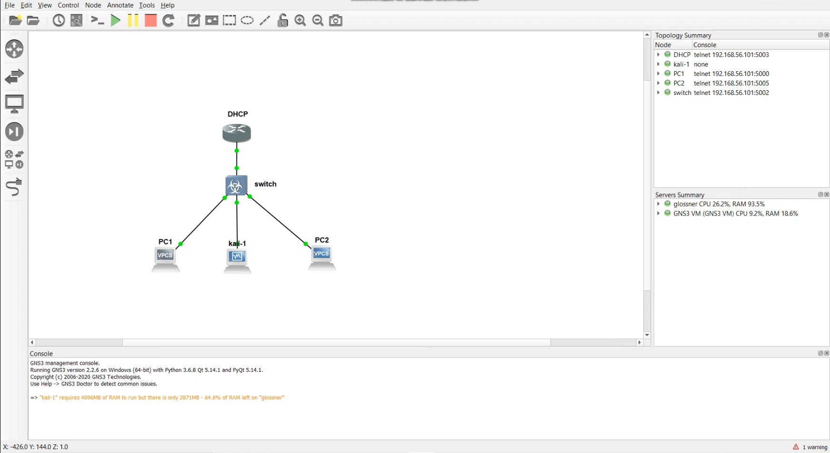
Topology(Denial of Service(DoS) Attack and
Man in the middle Attack)

Slide 5
Denial of Service(DoS) Attack
DHCP starvation attack is an attack that targets DHCP servers whereby forged DHCP requests are crafted by an attacker with the intent of making the DHCP server unavailable.
The attack is carried out using Yersinia tool present in the Kali Linux which generates fake DHCP Packets.
When a new machine tries to attain IP address from the DHCP server, the server does not responds due to the attack.

Slide 6
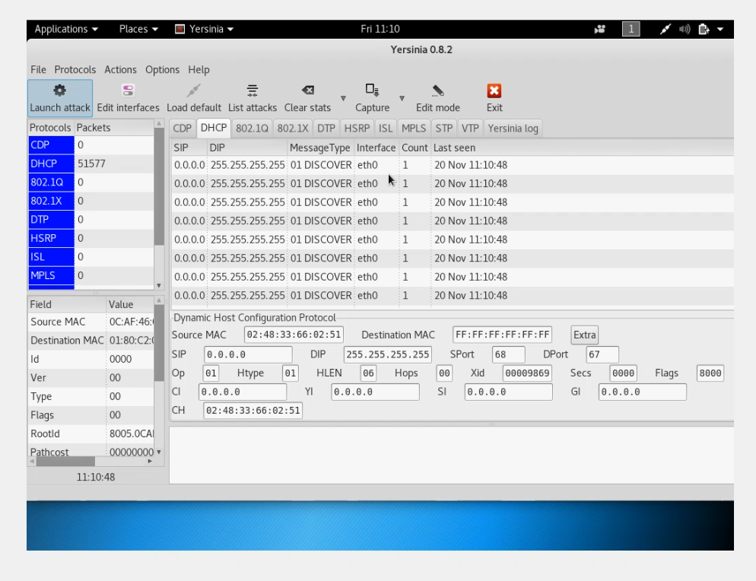
Demonstration screenshots

Slide 7
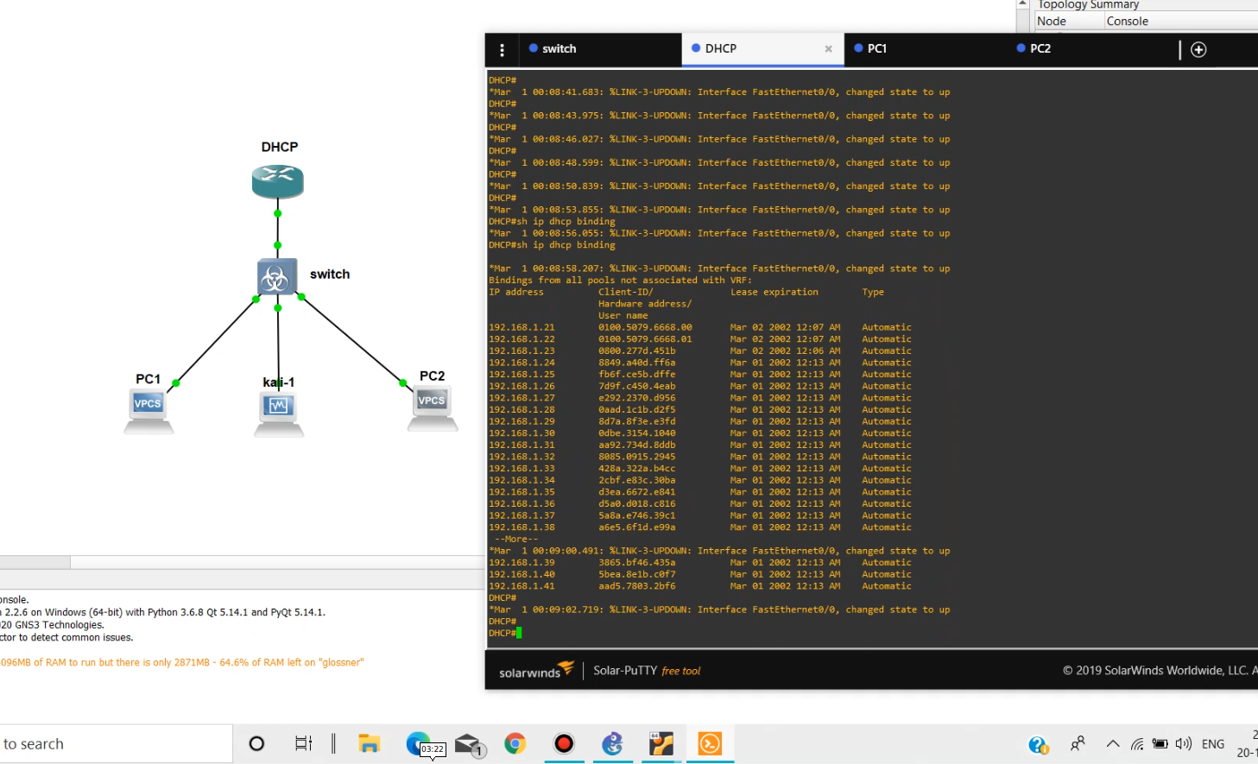
Demonstration screenshots

Slide 8
Man in the middle Attack
ARP Spoofing is a type of MITM attack where the attacker positions himself between the Target Machine and the Switch.
Arpspoof command sends fake ARP Requests packet both to the router and the target machine to change their ARP Tables.
When a ping command is carried out on target machine, the packets get forwarded to the attacker and then to the router

Slide 9
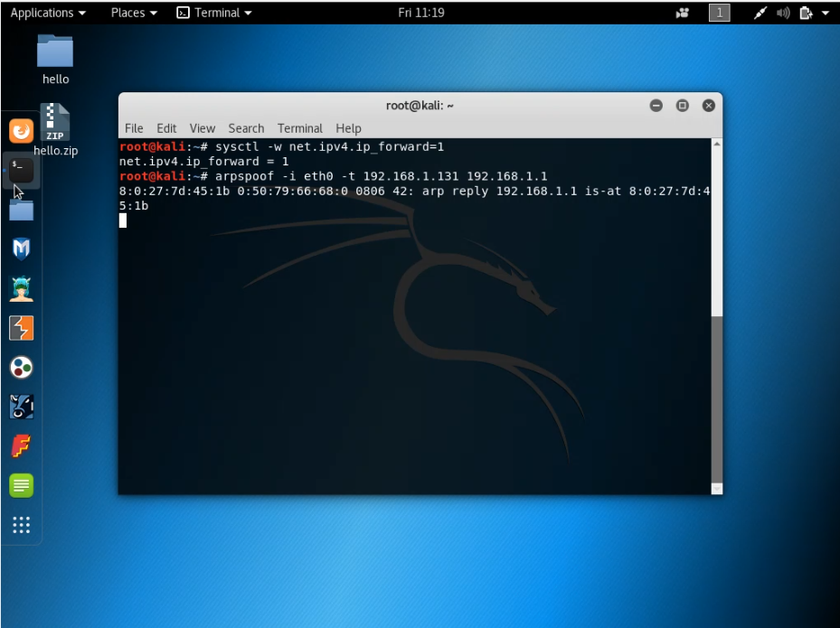
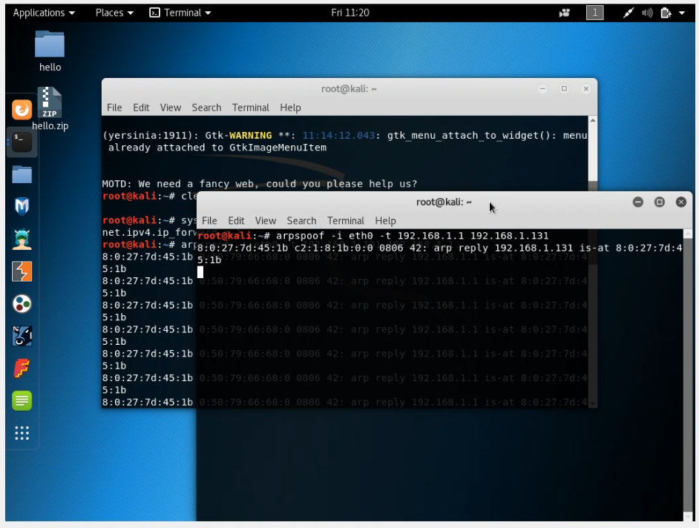
Demonstration screenshots

Slide 10
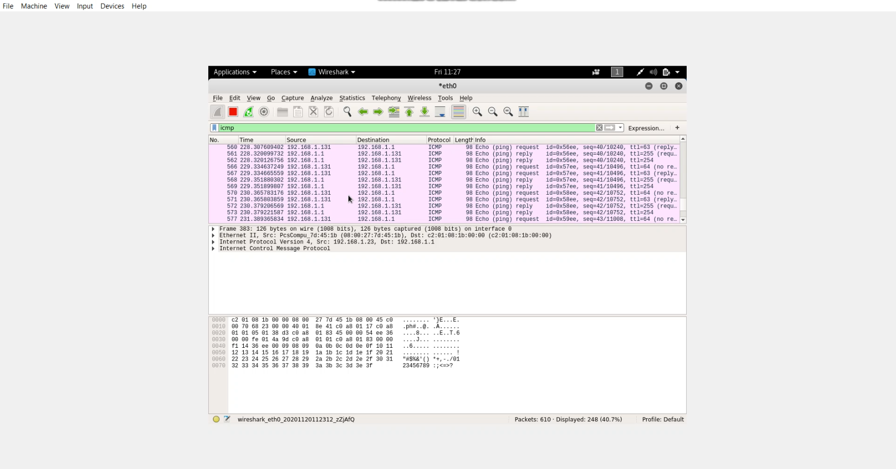
Demonstration screenshots

Slide 11
SQL Injection Attack
The site http://www.acfurniture.com/item.php?id=25 was chosen for the demonstration since it is vulnerable to SQL injection attacks.
Sqlmap toolkit was used to carry out the attack.
Set of vulnerable databases was collected.
The set of tables from acfurniture from which data could be retrieved was collected.
The vulnerable tables were category, product, product_hacked and settings.
Usernames and passwords were retrieved from the settings table.

Slide 12
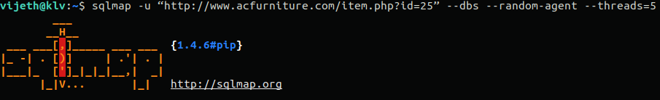
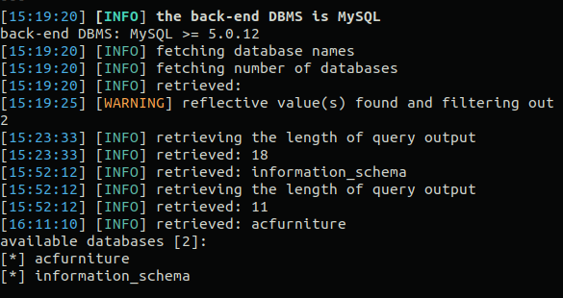
Vulnerable dbs

Slide 13
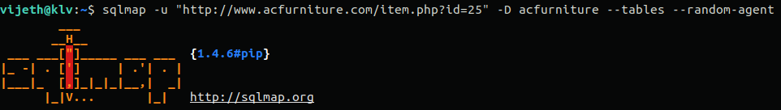
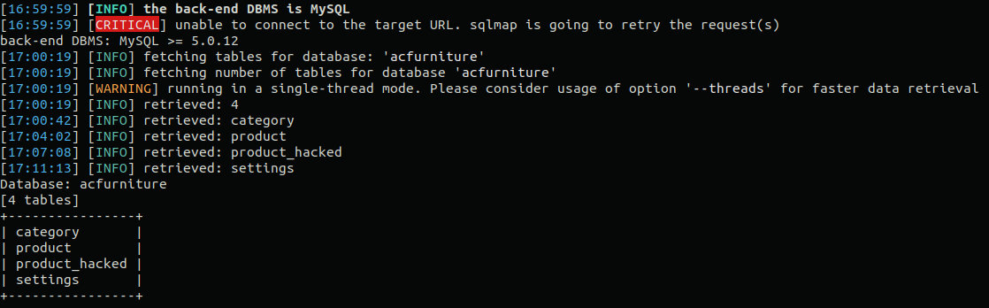
Vulnerable tables

Slide 14
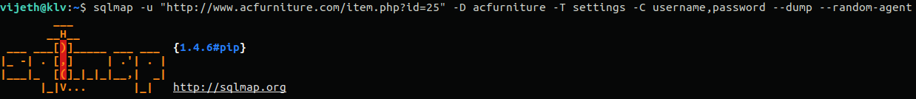
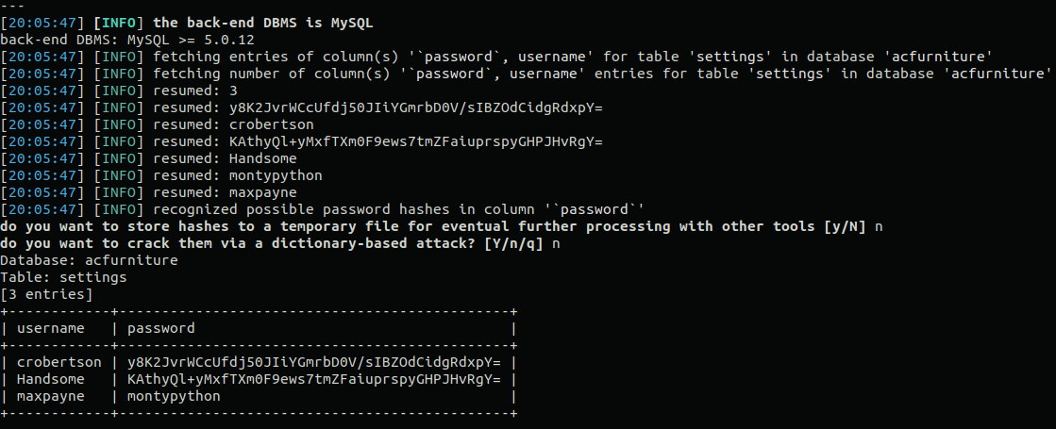
Usernames and hashed passwords

Slide 15
Phishing Attack
The phishing attack is demonstrated using two VM. One acting as Victim and one acting as attacker.
The site https:\\github.com\login was cloned to perform the attack using setoolkit.
A network in created between two vms(attacker and victim) with the subnet address 175.25.1.0 .
The cloned website is hosted on the attackers machine(VM in our case).
The victim(the other vm) accesses this cloned website thinking that it’s the actual website and enters the credentials.
These credentials can be accessed and exploited by the attacker.

Slide 16
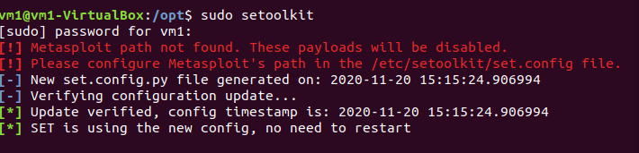
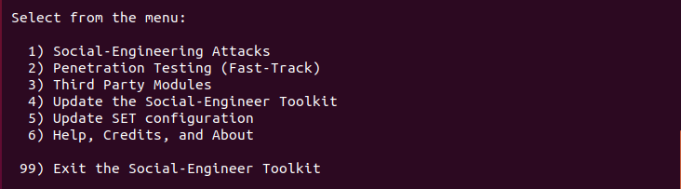
Demonstration screenshots

Slide 17
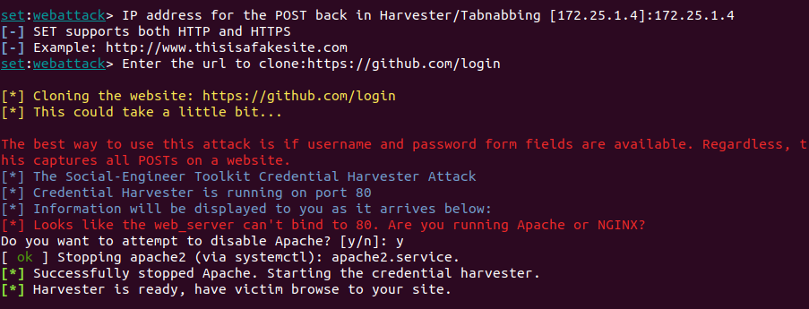
Hosting the cloned website

Slide 18
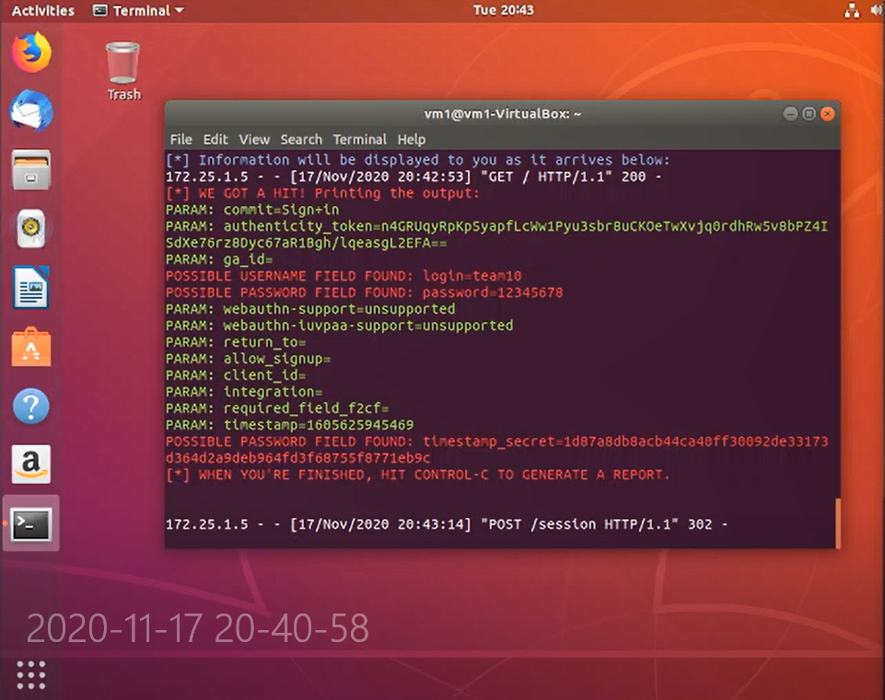
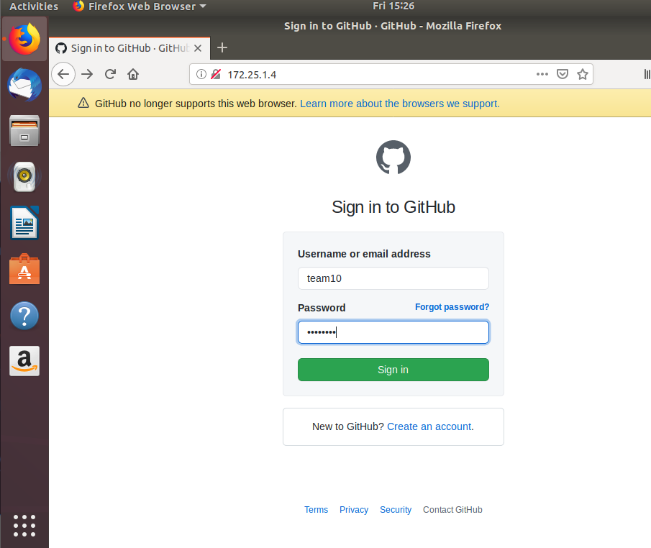
Accessing the cloned website

Slide 19
Brute Force Password Attack
The attacker systematically checks all possible passwords and passphrases until the correct one is found.
Brute-force attacks work by calculating every possible combination that could make up a password and testing it to see if it is the correct password.
As the password length increases, the amount of time, on average, to find the correct password increases exponentially.

Slide 20
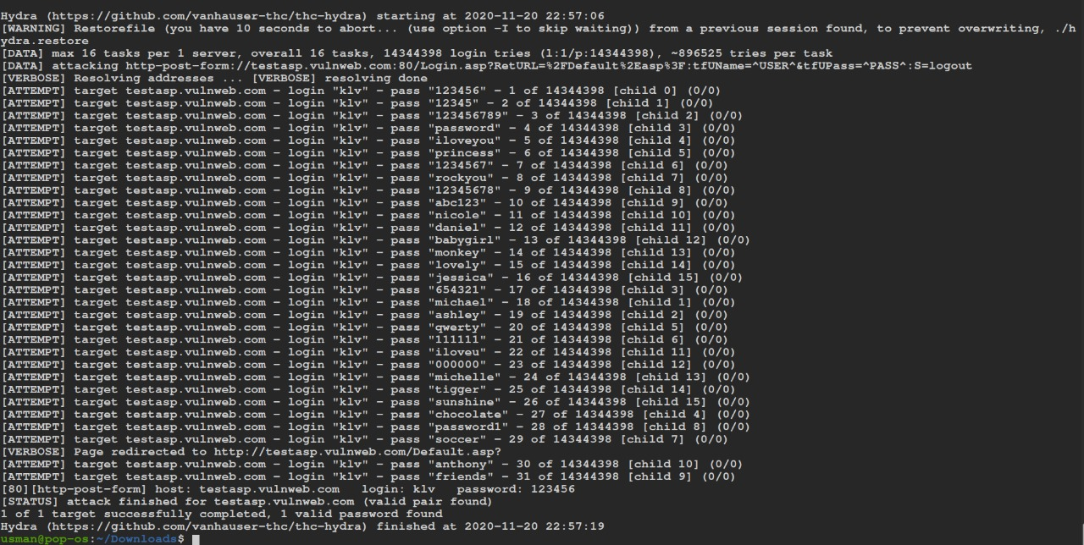
Demonstration screenshots

Slide 21
References
Ahmad, Khaleel. (2011). Classification of Internet Security Attacks.
Adeyinka, Olalekan. (2008). Internet Attack Methods and Internet Security Technology. 77-82. 10.1109/AMS.2008.68.
Gopal, Girdhar. (2016). CASE STUDY OF SQL INJECTION ATTACKS. 10.5281/zenodo.56935.
Vayansky, Ike & Kumar, Sathish. (2018). Phishing – challenges and solutions. Computer Fraud & Security. 2018. 15-20. 10.1016/S1361-3723(18)30007-1.
Chakraborty, Sushmita & Kumar, Praveen & Sinha, Bhawna & Professor, Assistant & Head,. (2019). A STUDY ON DDOS ATTACKS, DANGER AND ITS PREVENTION. 10.1729/Journal.20847.
Mallik, Avijit & Ahsan, Abid & Shahadat, Mhia & Tsou, Jia-Chi. (2019). Man-in-the-middle-attack: Understanding in simple words. 3. 77-92. 10.5267/j.ijdns.2019.1.001.
Knudsen, Lars & Robshaw, Matthew. (2011). Brute Force Attacks. 10.1007/978-3-642-17342-4_5.

Slide 22
Thank You

